Slide 1
SHERBORN’S INDEX ANIMALIUM INTEGRATION INTO ION: ACCESS TO ALL
NIGEL ROBINSON
DIRECTOR YORK OPERATIONS
28 OCTOBER 2011

Slide 2
AGENDA
INTRODUCTION
PROJECT
DEMONSTRATION OF IMPLEMENTATION
NEXT STEPS

Slide 3


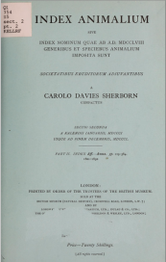


ZOOLOGICAL RECORD & INDEX ANIMALIUM
1758
1850
Index Animalium
1864
Zoological Record
founded
1999
ION created
Current ZR
and ION

Slide 4
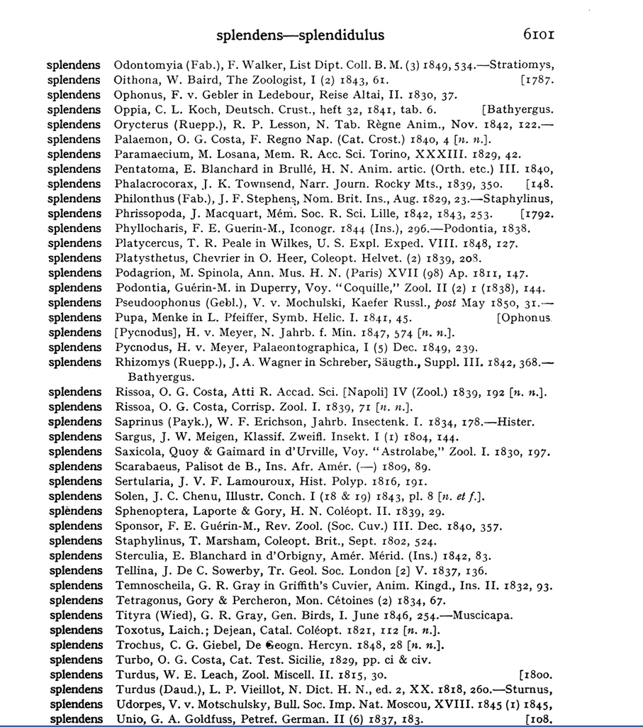
TEXT TO DATABASE
ID
Image ID
Page
Name & reference
"362382","SIL34_02_24_0193","6101","splendens Turdus, W. E. Leach, Zool. Miscell. II. 1815, 30.”
Notes:
More granularity needed to be a useful tool in detailed nomenclatural and bibliographic databases
Break down data into standard bibliographic and nomenclatural fields
Employ current ZR editorial processes and practices
Facilitate loading to ION through normal update processes

Slide 5

CHALLENGES
Interpretation of Index Animalium data
Inconsistent formatting, punctuation etc. in original books
OCR errors
Variant publication titles
Application of management classification

Slide 6
NORMALISED DATA RECORD
Genus: Turdus
Species: splendens
Name string: Turdus splendens
Author lastname: Leach
Author forename: W.E.
Abbreviated publication name: Zool. Miscell.
Full publication name: The Zoological Miscellany
Volume: II
Year: 1815
Page: 30
Bibliographic record
Classification routines
ZR style entry
Standard data load and QC

Slide 7
PROCESS FLOW
BIODIVERSITY COMMUNITY
OUTPUT FILES
ION
DATA WAREHOUSE (in standard format)
ZR CLASSIFICATION APPLIED
Correction cycles
PARSING ROUTINES
INPUT FILE
Notes:
IA data csv file
Parsing algorithms
Normalised data loaded to data warehouse
ZR classification applied
Further QC, clean up
Assignment of BHL links
Load to ION, assignment of LSID
Update capabilities

Slide 8
DEMONSTRATION

Slide 9
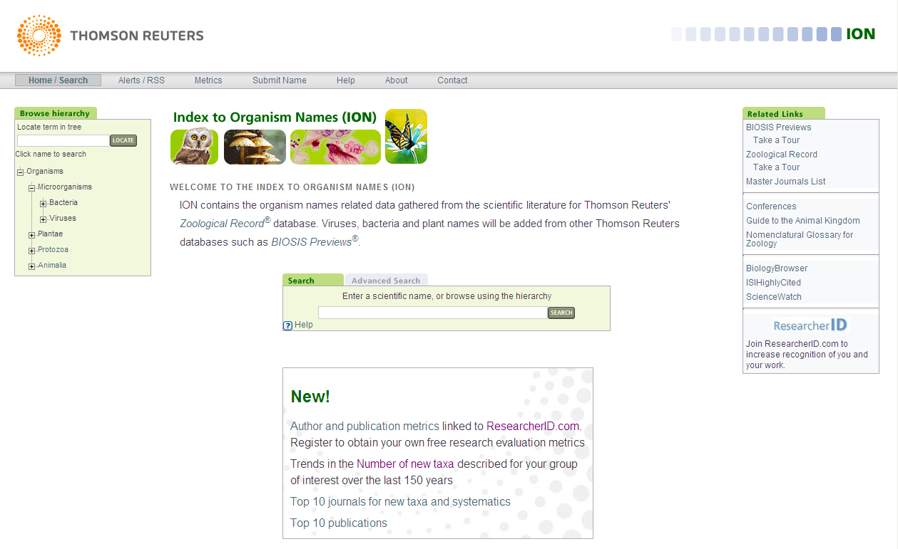
INDEX TO ORGANISM NAMES SEARCH
Turdus splendens

Slide 10
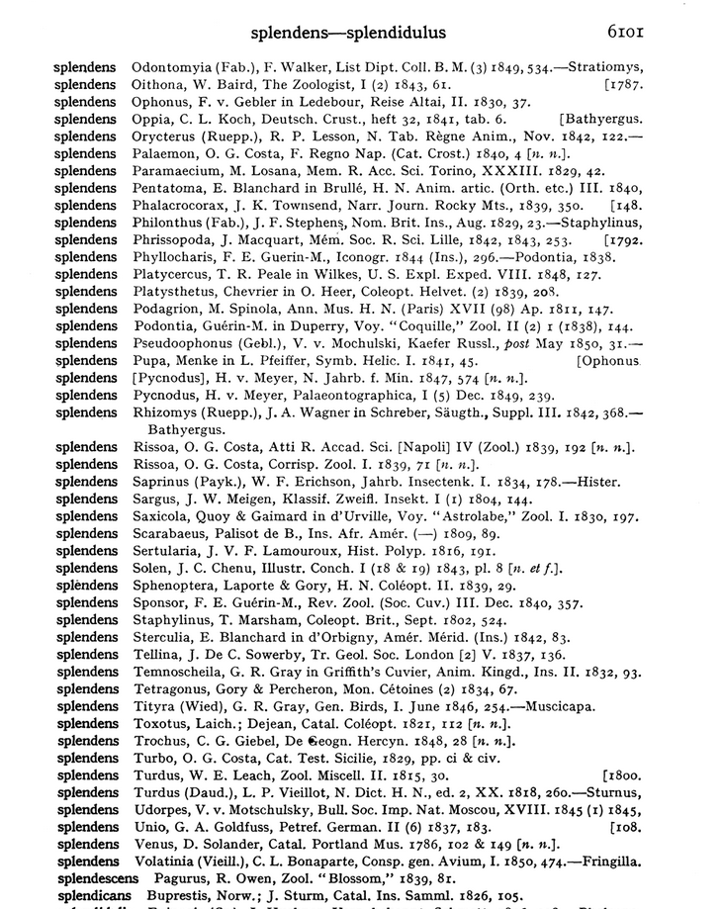
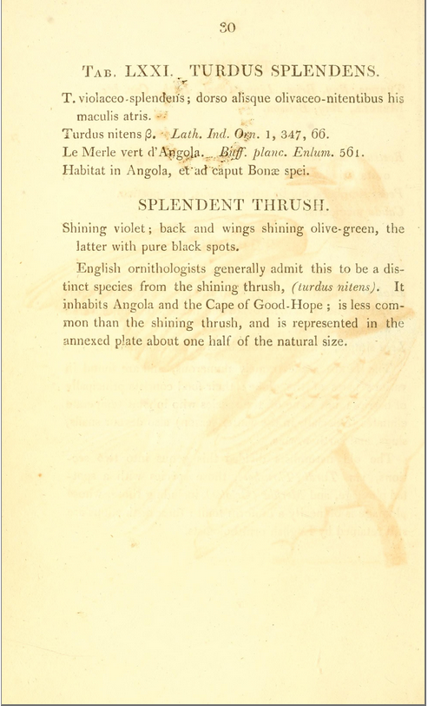
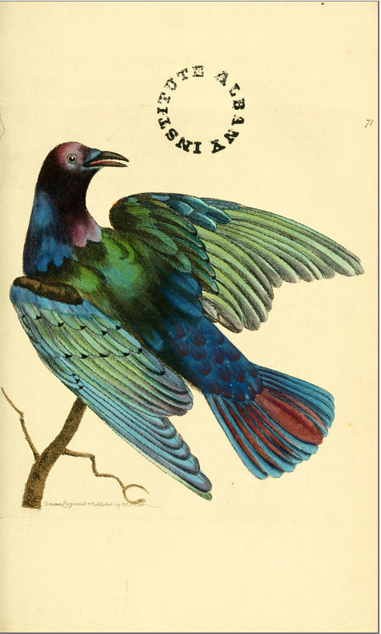
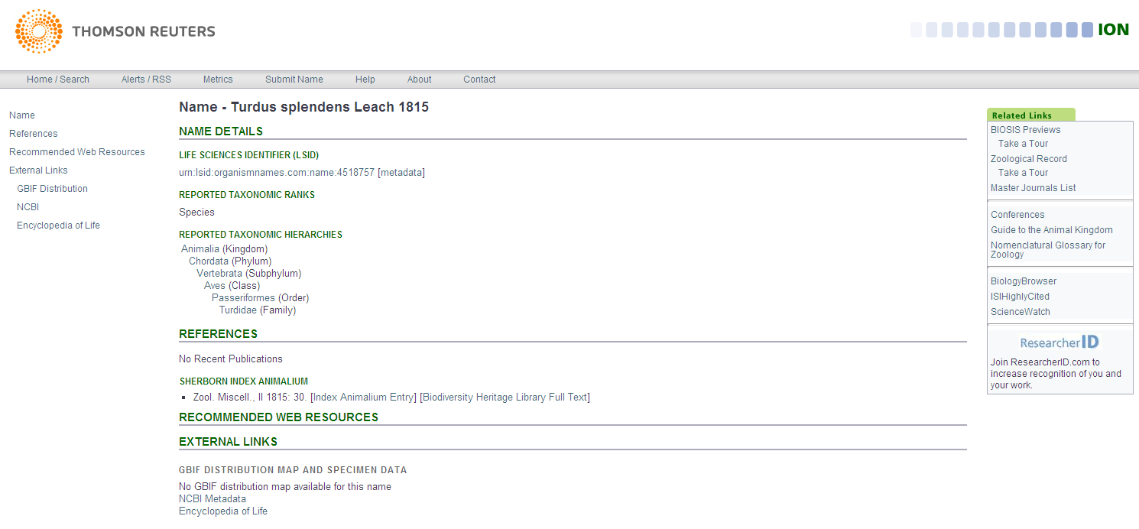
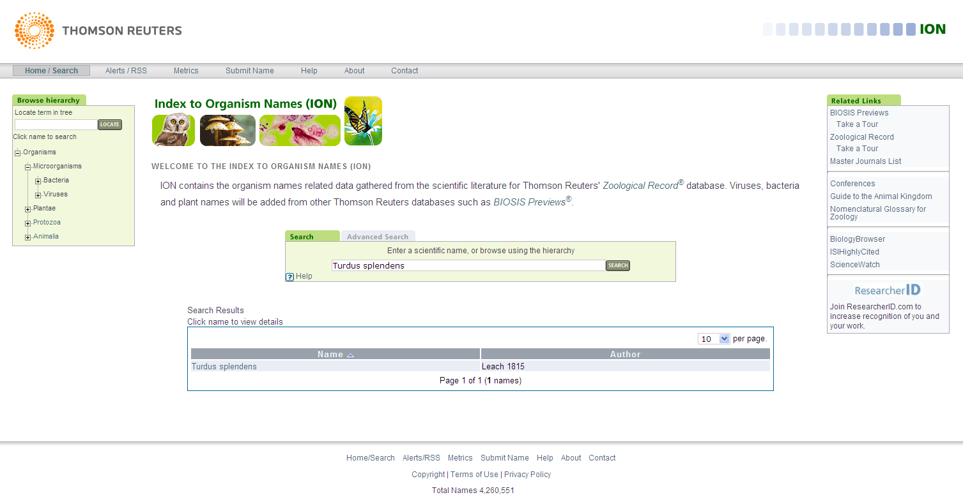
RESULTS AND VIEWS

Slide 11
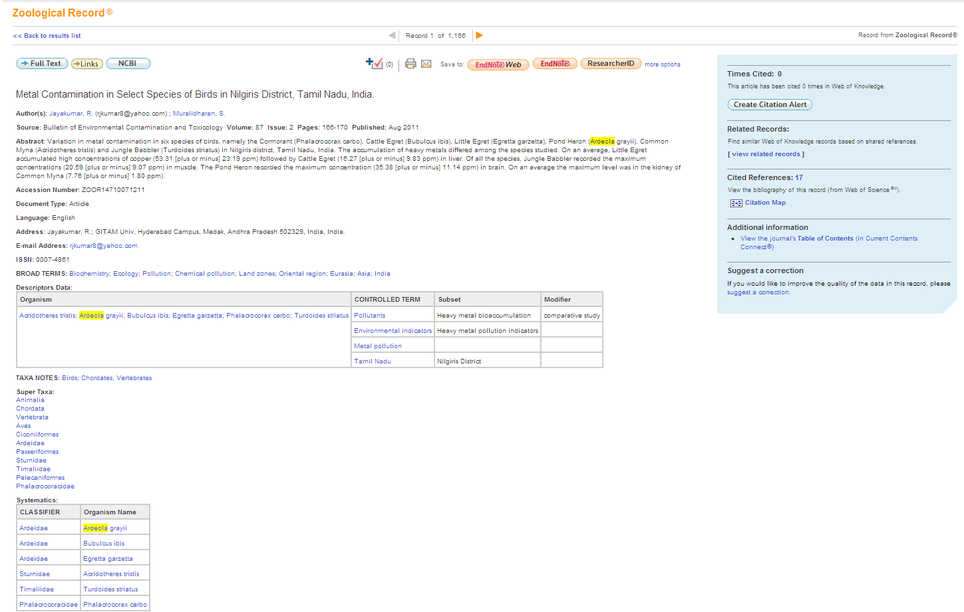
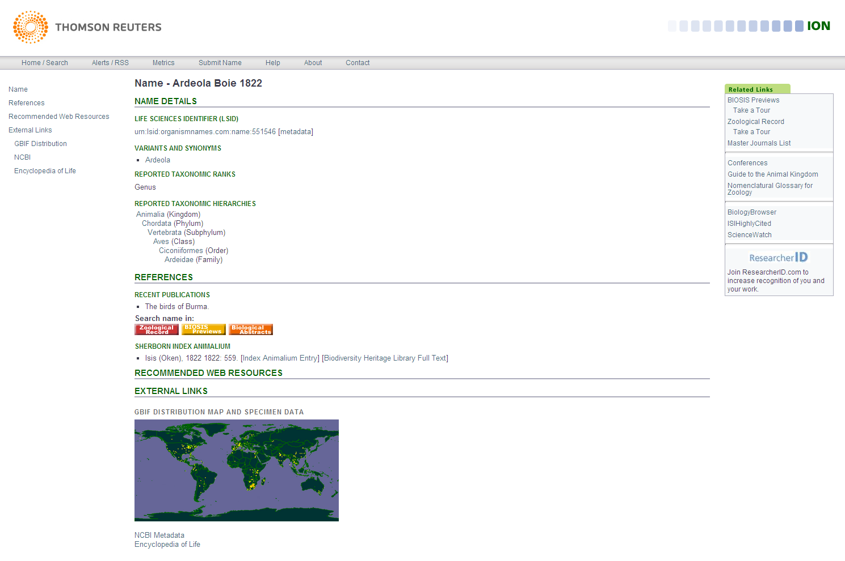
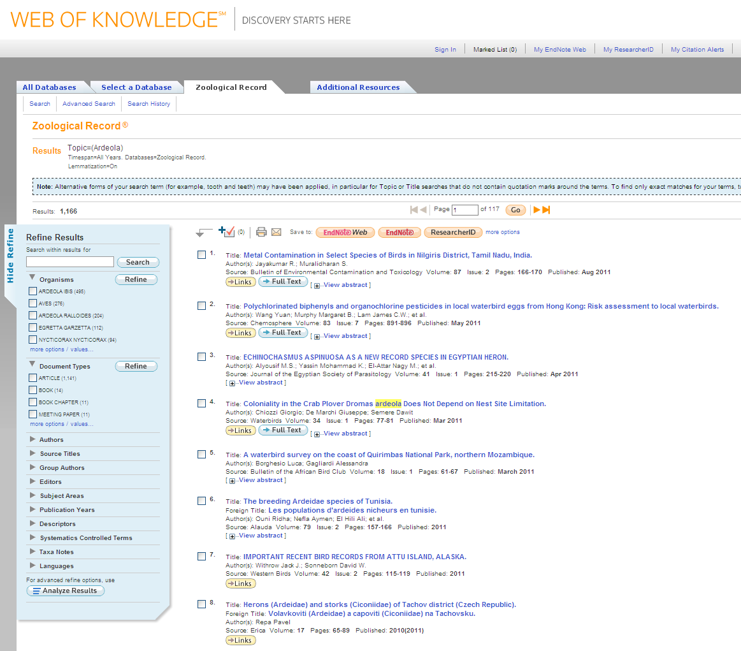
DETAILS - MERGED RECORD

Slide 12
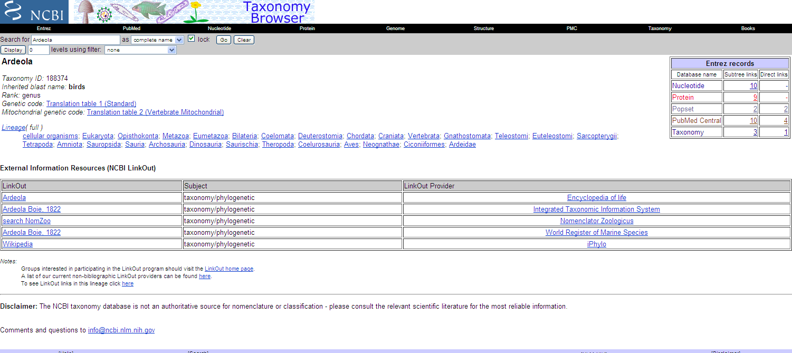
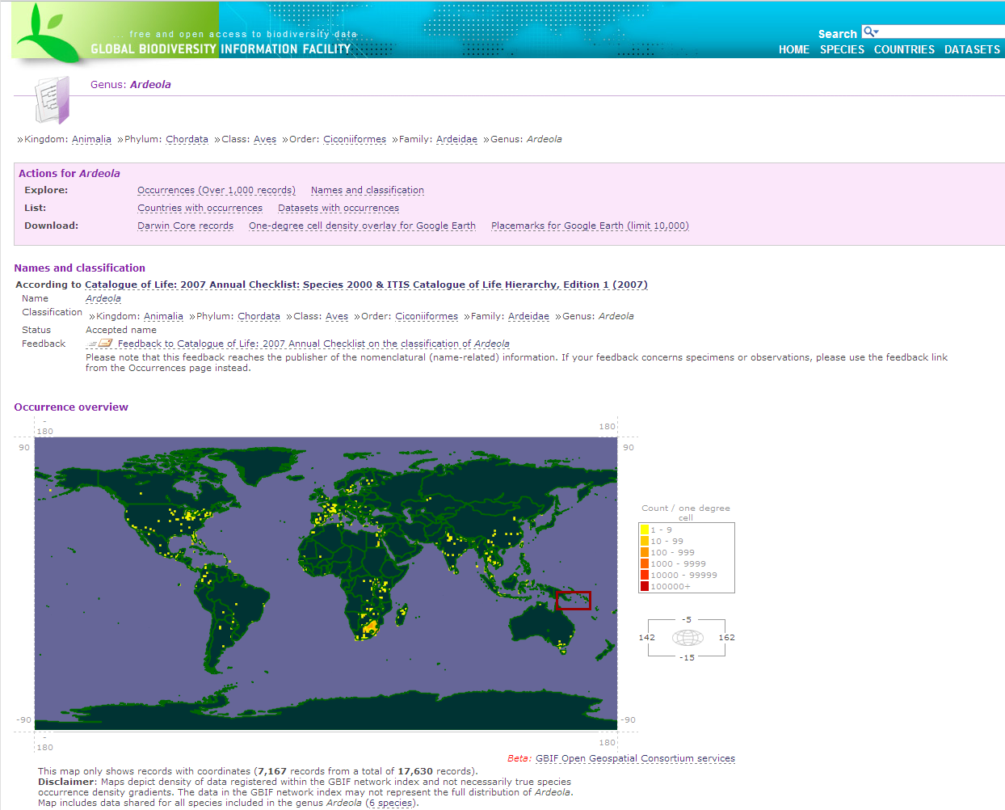
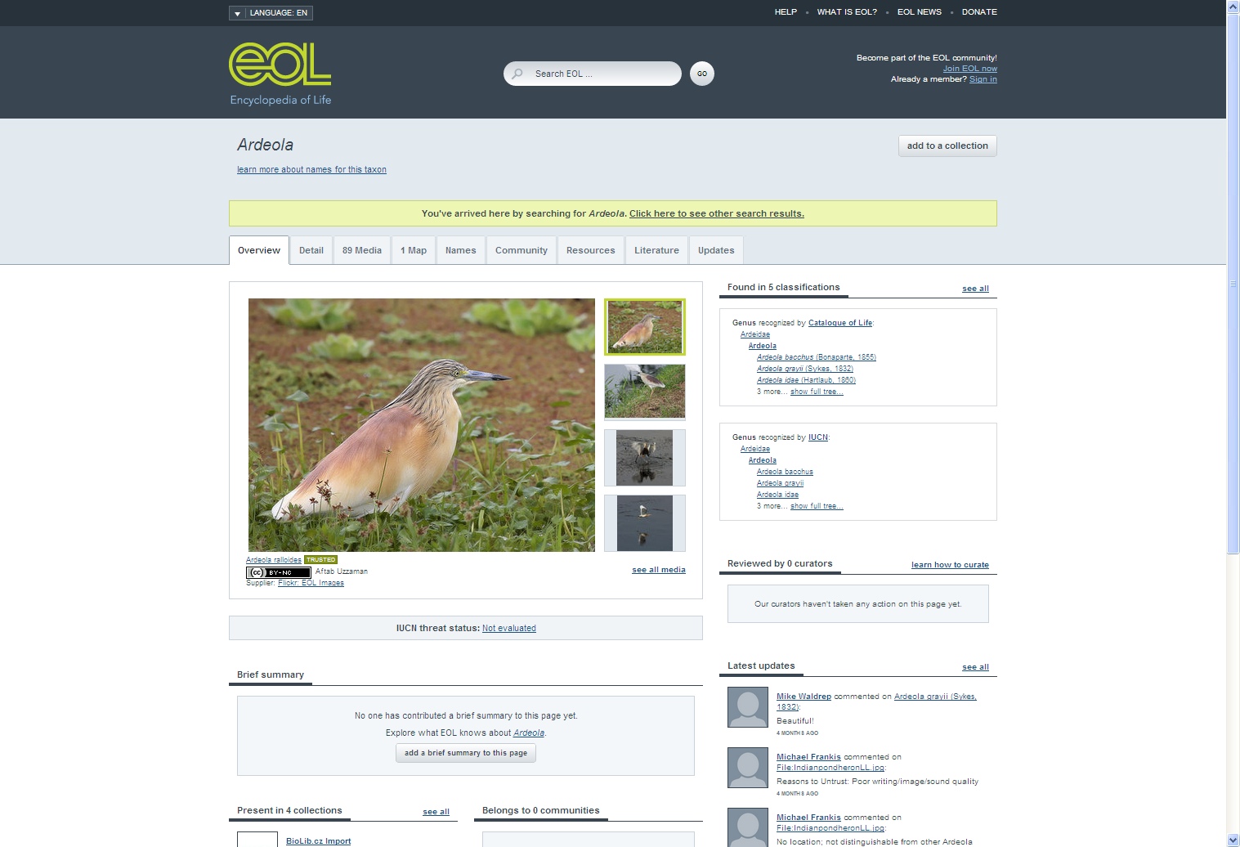
LINK OUT FOR ADDITIONAL INFORMATION

Slide 13
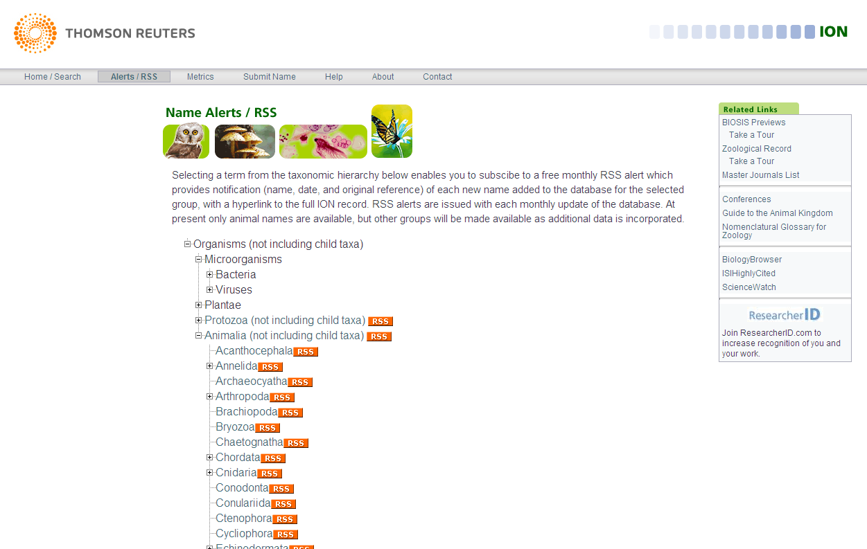
UPDATE NOTIFICATIONS – RSS ALERTS

Slide 14
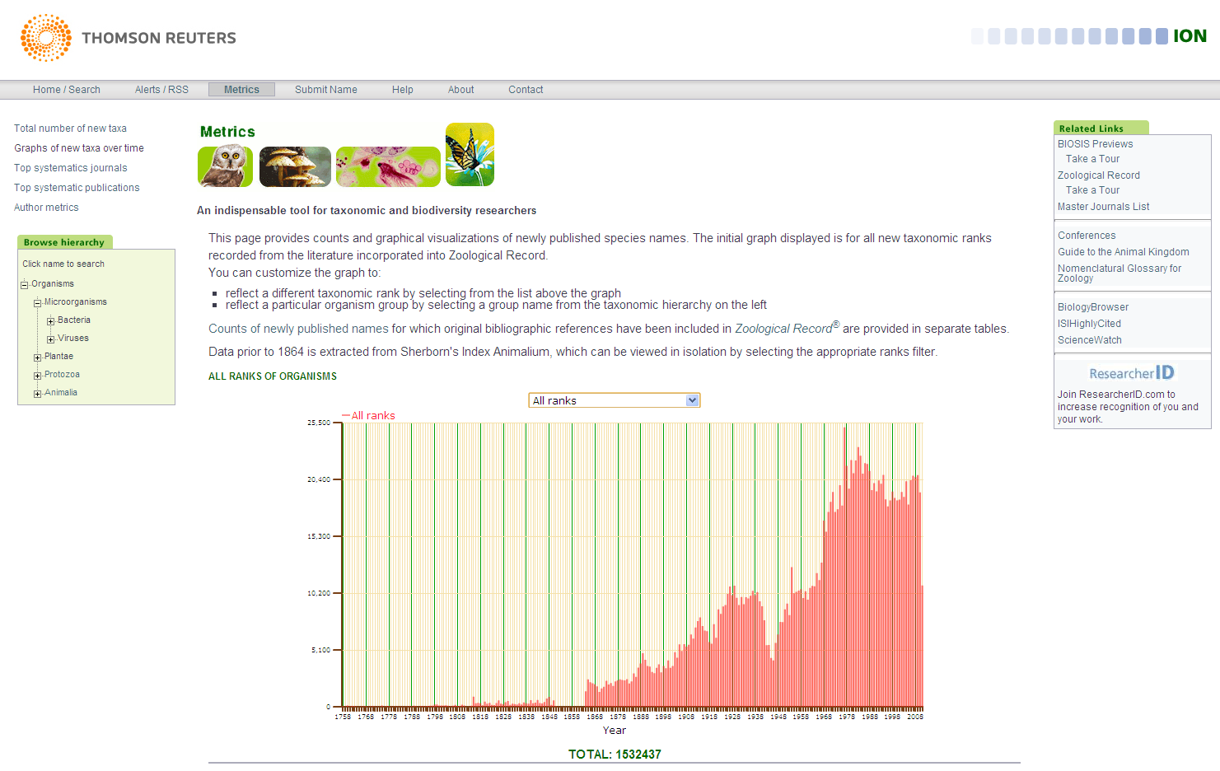
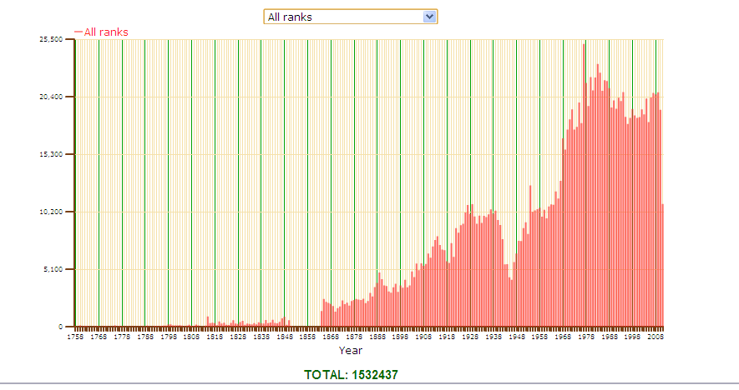
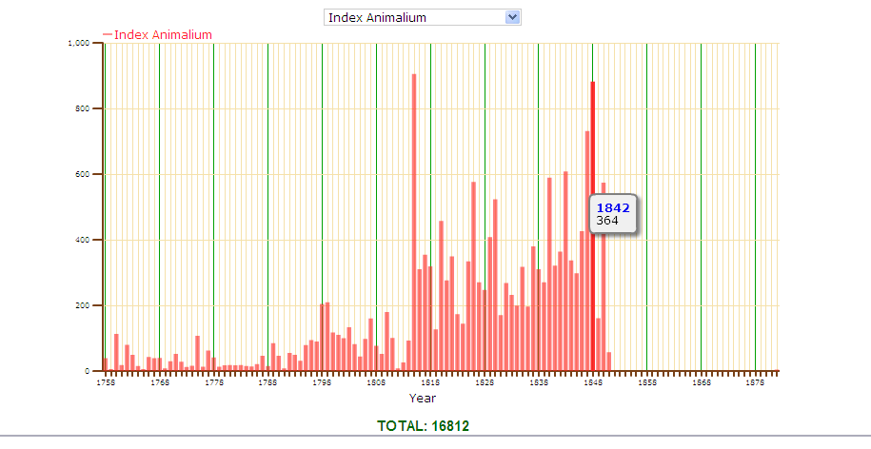
METRICS INTEGRATION

Slide 15
NEXT STEPS
2011
Load next 200,000 names
2012
Load remaining names
Publication name unification
Apply unification and links to BHL
Further processing of remaining names
Web services and APIs

Slide 16
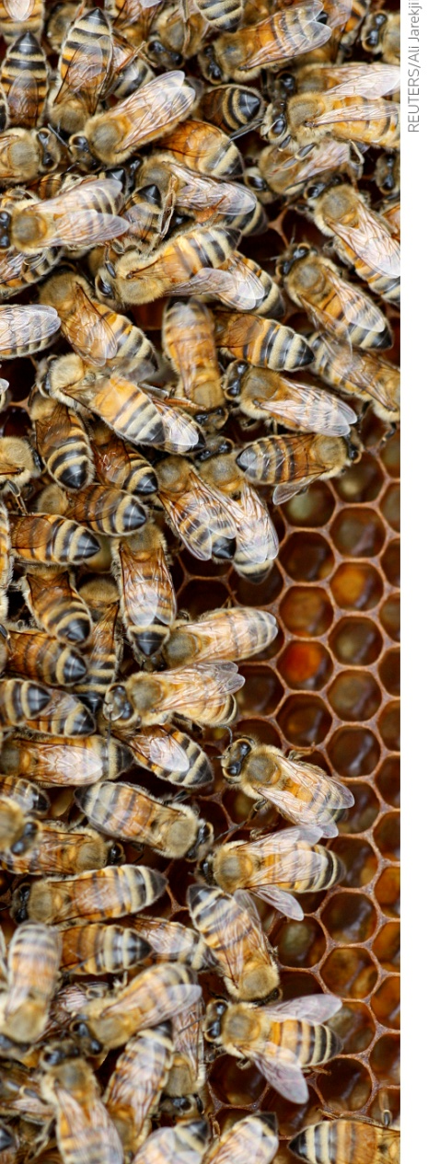
BENEFITS OF COLLABORATION
Zoological Record production
Authority file validation
Resolution of homonyms in ZR production
Enable notification to authors
Increased links to literature and ZR in ION
Extends the list of names used in the literature to 1758
Homonym checks
Data available for other projects
More granular digital format
Cleaner version of the data

Slide 17
QUESTIONS??
Access
http://www.organismnames.com
Contact
nigel.robinson@thomsonreuters.com

